Slide 1
Behaviour Trees Session 08
Course : COMP6228 – Artificial Intelligence
Effective Period : February 2018

Slide 2
Learning Objective
After completing this session, students are expected to be able to:
LO 2 : Explain concepts of AI Techniques in Games

Slide 3
Content
Implementing Behavior Trees
Decorators
Concurrency and Timing

Slide 4
Behaviour Trees
Behaviour trees have become a popular tool for creating AI characters.
Halo 2 (2004) was one of the first high-profile games for which the use of behaviour trees was described in detail and since then many more games have followed suit.
Behaviour trees have a lot in common with Hierarchical State Machines but, instead of a state, the main building block of a behaviour tree is a task.
A task can be something as simple as looking up the value of a variable in the game state, or executing an animation.
Tasks are composed into sub-trees to represent more complex actions.

Slide 5
Behaviour Trees
Types of Task
Our simple behaviour trees will consist of three kinds of tasks: Conditions, Actions, and Composites.
Conditions
Conditions test some property of the game
Actions
Actions alter the state of the game.
Composites
We’ll consider two types of Composite tasks: Selector and Sequence
A Selector will return immediately with a success status code when one of its children runs successfully
A Sequence will return immediately with a failure status code when one of its children fails.

Slide 6
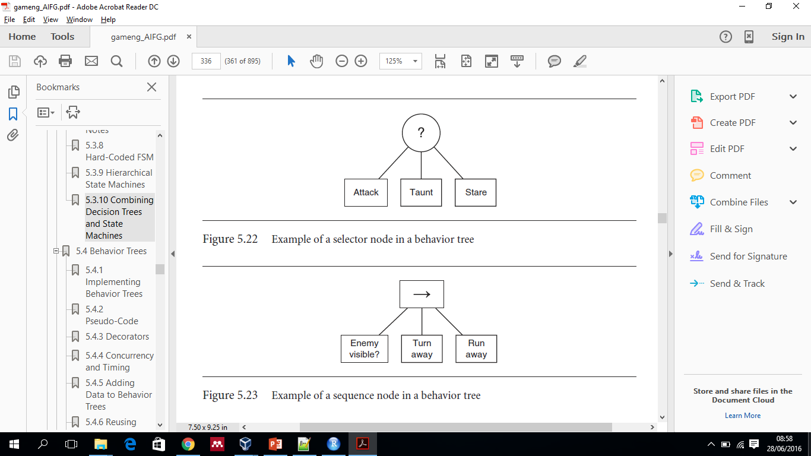
Behaviour Trees
Example of a selector node in a behaviour tree
Example of a sequence node in a behaviour tree

Slide 7
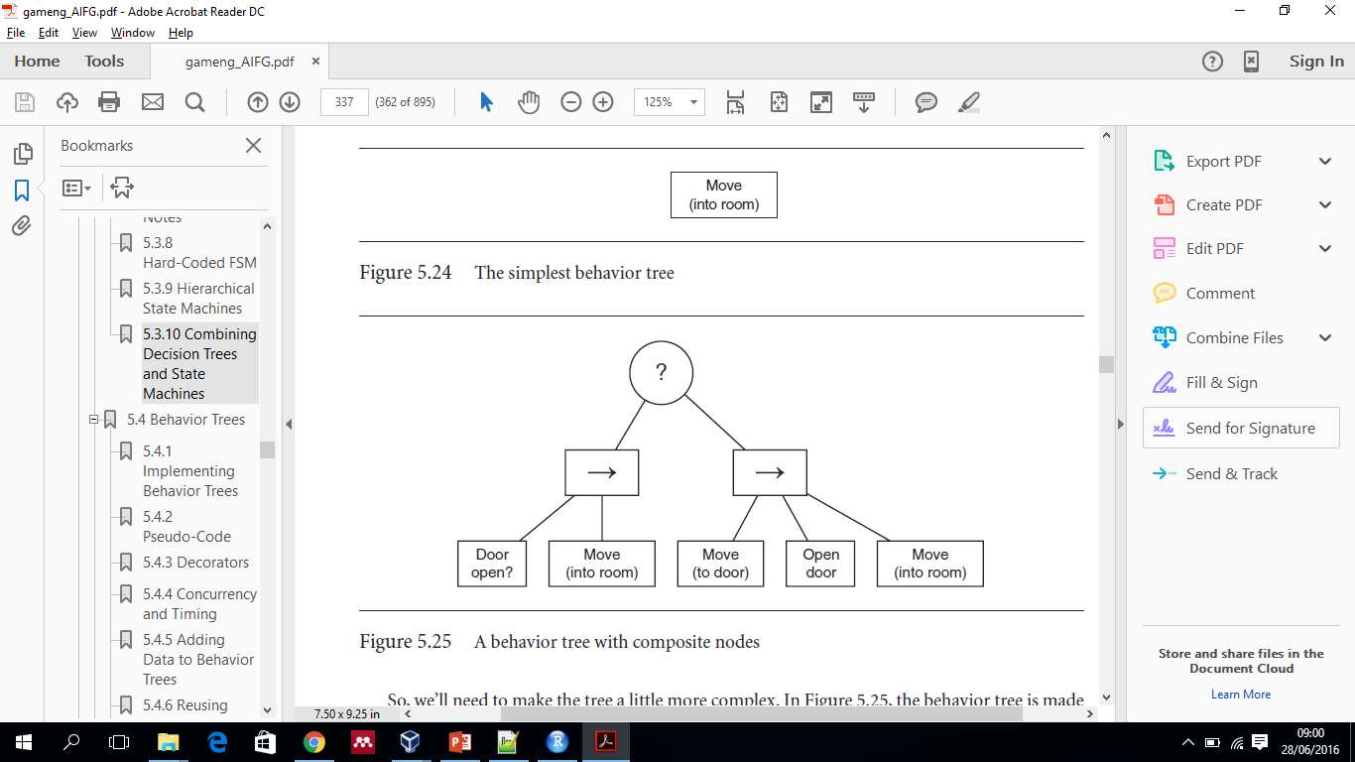
Behaviour Trees
A Simple Example
The simplest behavior tree
A behaviour tree with composite nodes

Slide 8
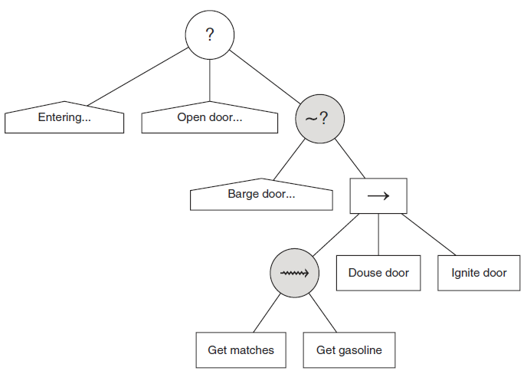
Implementing Behaviour Trees
Behaviour trees are made up of independent tasks, each with its own algorithm and implementation.
All of them conform to a basic interface which allows them to call one another without knowing how they are implemented.
Example behaviour tree with partial ordering

Slide 9
Decorators
So far we’ve met three families of tasks in a behaviour tree: Conditions, Actions, and Composites. There is a fourth that is significant: Decorators.
The name “decorator” is taken from object-oriented software engineering.
The decorator pattern refers to a class that wraps another class, modifying its behaviour.
In the context of a behaviour tree, a Decorator is a type of task that has one single child task and modifies its behaviour in some way.
One simple and very common category of Decorators makes a decision whether to allow their child behaviour to run or not (they are sometimes called “filters”)

Slide 10
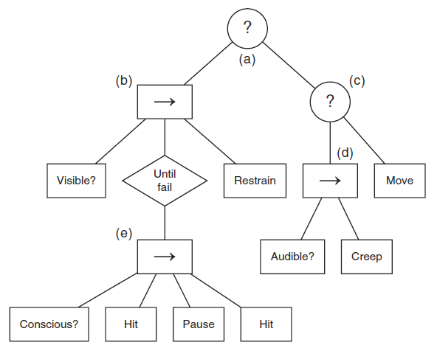
Decorators
Example behaviour tree

Slide 11
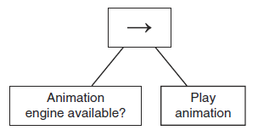
Decorators
Guarding Resources with Decorators
Often, parts of a behaviour tree need to have access to some limited resource. In the example this was the skeleton of the character. The animation engine can only play one animation on each part of the skeleton at any time. If the character’s hands are moving through the reload animation, they can’t be asked to wave.
Guarding a resource using a Condition and Selector

Slide 12
Concurrency and Timing
One approach to implementing this concurrency is to imagine each behaviour tree is running in its own thread. That way an Action can take seconds to carry out: the thread just sleeps while it is happening and wakes again to return True back to whatever task was above it in the tree.
A more difficult approach is to merge behaviour trees with the kind of cooperative multitasking and scheduling algorithms.
In practice, it can be highly wasteful to run lots of threads at the same time, and even on multi-core machines we might need to use a cooperative multitasking approach, with one thread running on each core and any number of lightweight or software threads running on each.

Slide 13
Concurrency and Timing
The Parallel Task
In our new concurrent world, we can make use of a third Composite task. It is called “Parallel,” and along with Selector and Sequence it forms the backbone of almost all behaviour trees.
The Parallel task acts in a similar way to the Sequence task. It has a set of child tasks, and it runs them until one of them fails. At that point, the Parallel task as a whole fails. If all of the child tasks complete successfully, the Parallel task returns with success. In this way, it is identical to the Sequence task and its non-deterministic variations.
The difference is the way it runs those tasks. Rather than running them one at a time, it runs them all simultaneously. We can think of it as creating a bunch of new threads, one per child, and setting the child tasks off together.

Slide 14
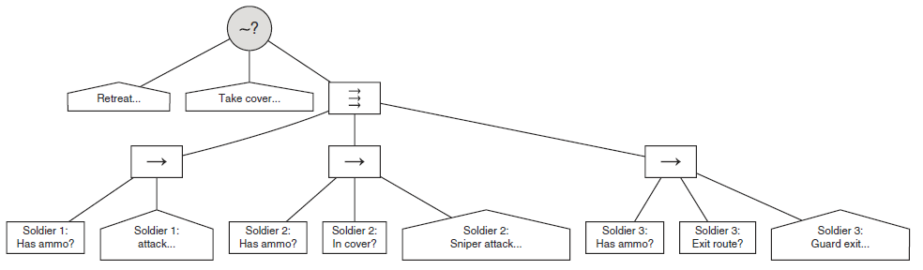
Concurrency and Timing
Using Parallel to implement group behaviour

Slide 15
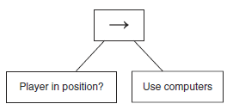
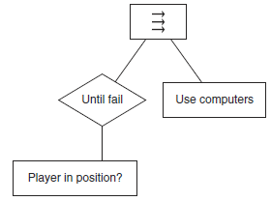
Concurrency and Timing
The Parallel Task for Condition Checking
Using Sequence to enforce a Condition
Using Parallel to keep track of Conditions

Slide 16
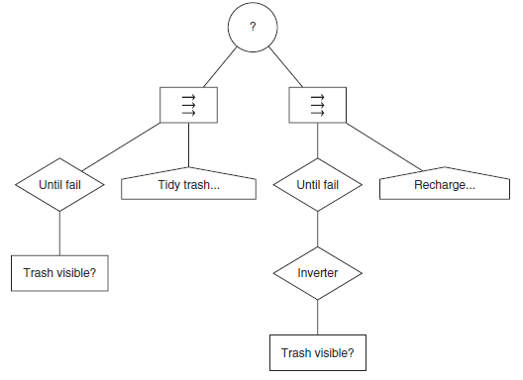
Concurrency and Timing
Intra-Task Behaviour
A behaviour tree version of a state machine

Slide 17
References
Ian Millington. 2009. Artificial intelligence for games. Morgan Kaufmann Publishers. Burlington. ISBN:9780123747310
Decision Making, https://www.cs.umd.edu/class/spring2013/cmsc425/Lects/lect20.pdf

